Slide 1
Tampere Goes Agile
28/10/2017
SpotiSAFeLeSS?
Is it even a model to scale agile?
Artur Margonari
Agile Coach, Trainer and Facilitator

Slide 2
Managing expectations
Notes:
MAINLY REX of a big agile transformation
No certifications SAFe, LeSS and definitely not Spotify
No Specific names (org or people)
I might not have answers for every single question
And therefore, you might not be able to go to your organization and implemen the same…

Slide 3
Before talking about scaling agile...
Definition of “model”
?
Notes:
NPS, Customer satisfaction, employee satisfaction

Slide 4
Definitions of ‘model’, by Oxford Dictionaries
A three-dimensional representation of a person or thing or of a proposed structure, typically on a smaller scale than the original.
A thing used as an example to follow or imitate.
A simplified description, especially a mathematical one, of a system or process, to assist calculations and predictions.
A person employed to display clothes by wearing them.
A particular design or version of a product.

Slide 5
And…
Definition of “framework”
?
Notes:
NPS, Customer satisfaction, employee satisfaction

Slide 6
Definitions of ‘Framework’, by Oxford Dictionaries
An essential supporting structure of a building, vehicle, or object.
A basic structure underlying a system, concept, or text.

Slide 7
Existing models/frameworks to scale
agile?
Notes:
QUIZZ WITH THE POSTIS
AGILE, Scrum, DAD, SAFe, LeSS, Nexus, Spotify,

Slide 8
Time to use the postits ☺
Notes:
AGILE, scrum… etc….

Slide 9
Quick check
about the knowledge
of three
of these models
Notes:
AGILE, scrum… etc….

Slide 10
SAFe
Scale Agile Framework
Notes:
Talk about the abbreviation of SAFe itself: what’s framework by the way?

Slide 11
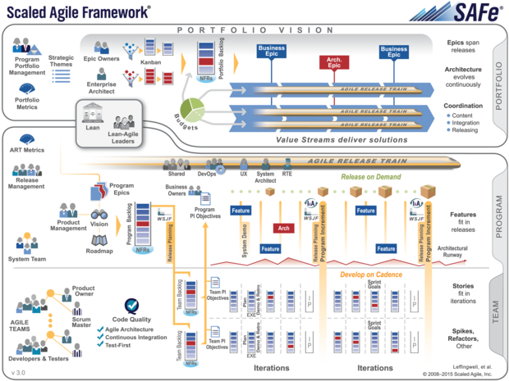
SAFe
Notes:
The first official release of SAFe was published on its current website in 2011.
version 4.5, was released in June 2017

Slide 12
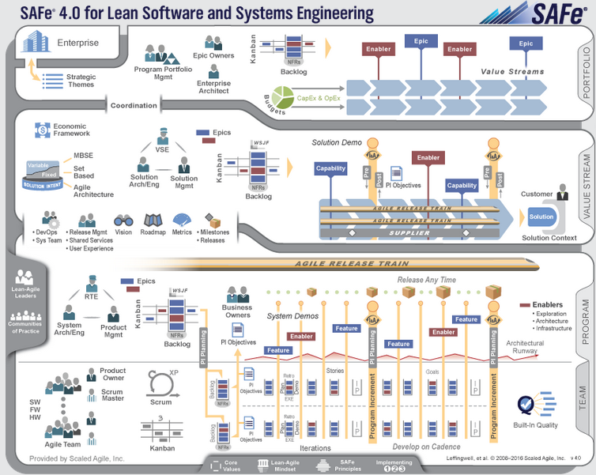
SAFe
Notes:
The first official release of SAFe was published on its current website in 2011.
version 4.5, was released in June 2017

Slide 13
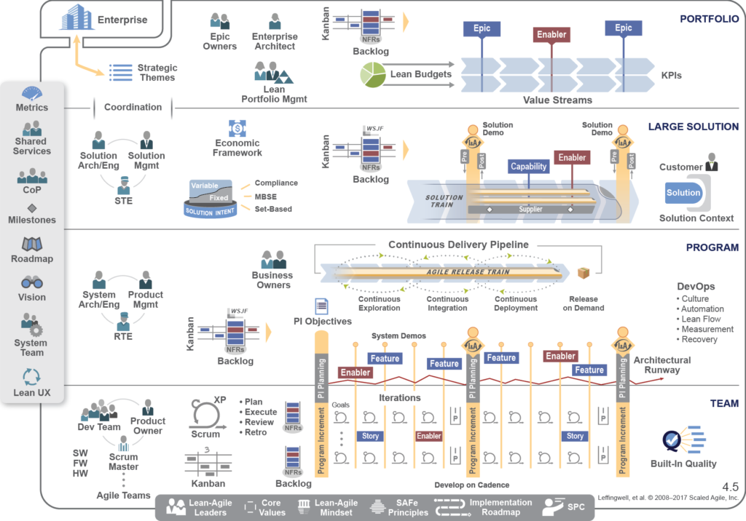
SAFe
SAFe BIG PICTURE
Notes:
The first official release of SAFe was published on its current website in 2011.
version 4.5, was released in June 2017

Slide 14
SAFe?
“(…) It is as an online freely revealed knowledge base of proven success patterns for implementing Lean-Agile software and systems at enterprise scale.”

Slide 15
SAFe 4.0 – SAFe 4.5
FULL SAFe x SAFe Lean Enterprises

Slide 16
LeSS Large Scale Scrum
Notes:
-

Slide 17
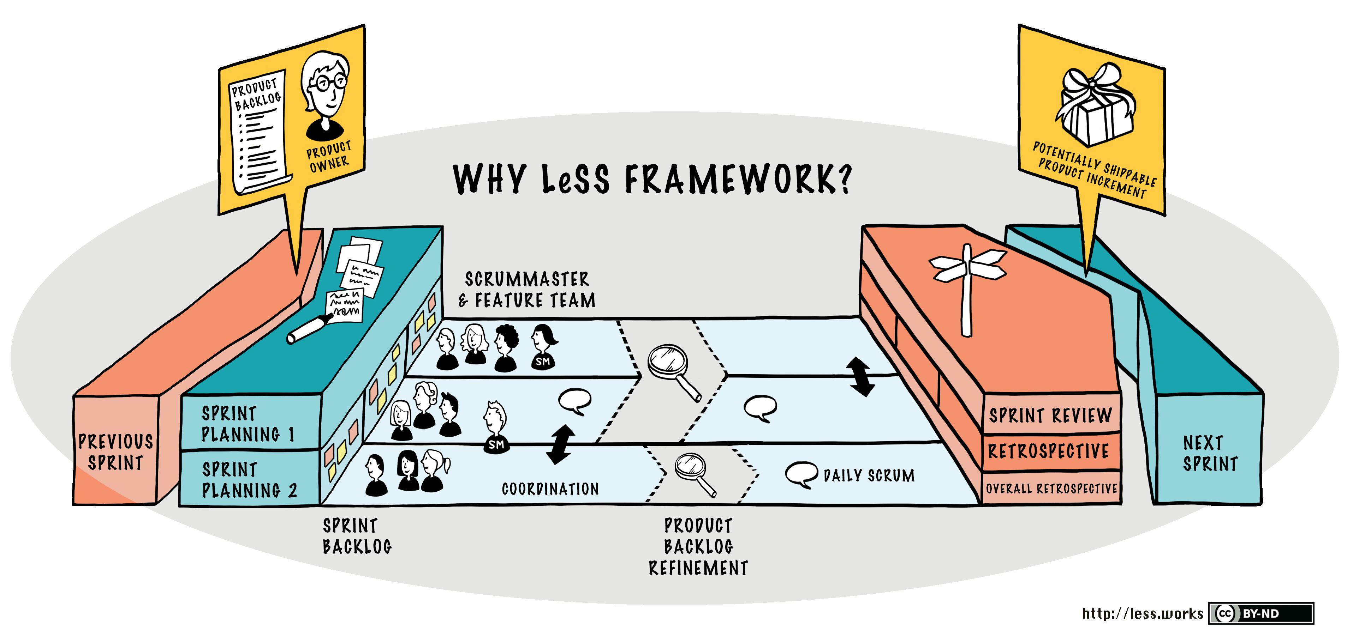
LeSS
Notes:
LeSS:
Chief PO = PO // Normal PO becomes APO (Area Product Owner) // 1 PB // 1 Sprint Backlog per team //1 SM per 1-3 teams

Slide 18
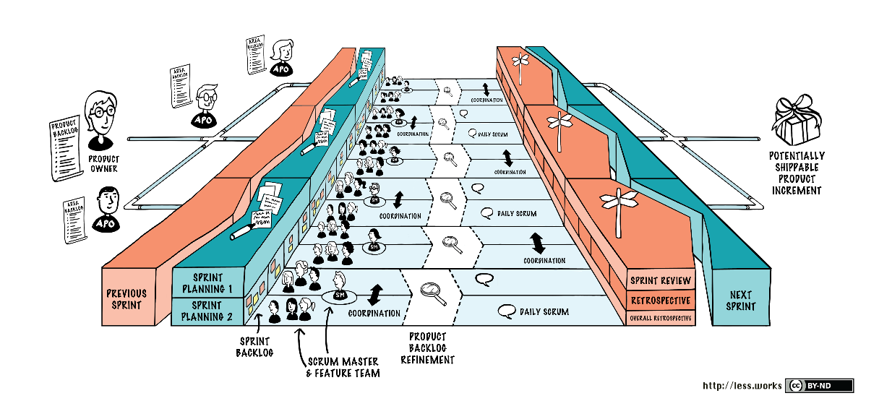
LeSS HUGE
Notes:
LeSS HUGE:
Max 8 teams per PB

Slide 19
LeSS
“(…) Agile development with Scrum requires a deep organizational change to become agile. Therefore, neither Scrum nor LeSS should be considered as merely a practice. Rather, they form an organizational design framework.”

Slide 20
Spotify
Notes:
-

Slide 21
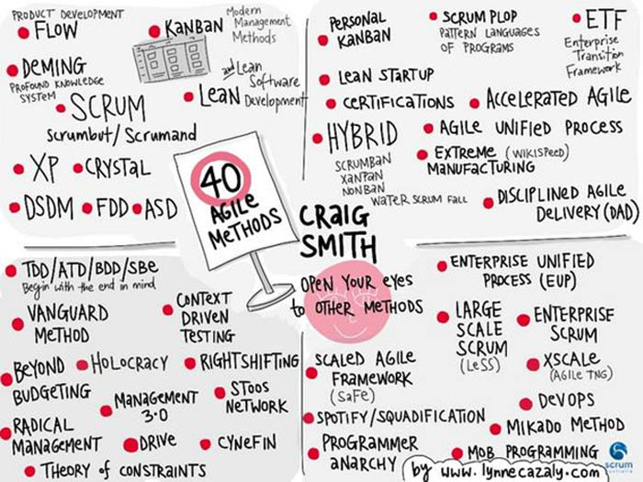

Slide 22
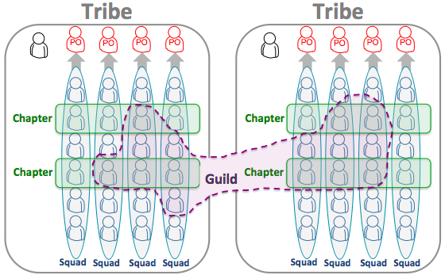
Spotify
Notes:
GO TO 7:25 “We never used but now it’s full circle and we also use it...”

Slide 23
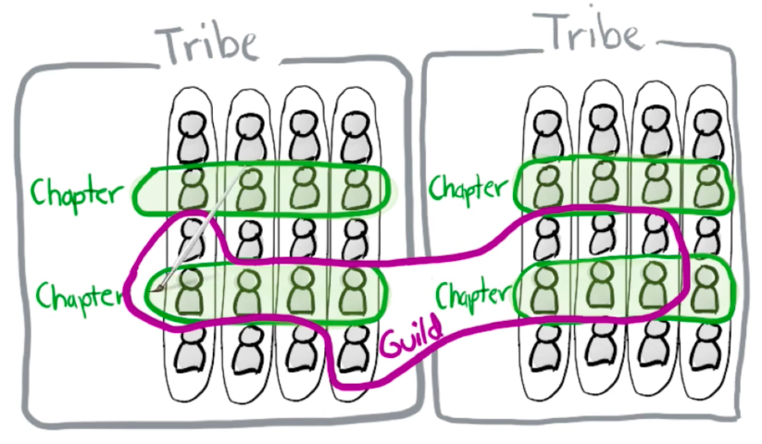
Spotify
Notes:
GO TO 7:25 “We never used but now it’s full circle and we also use it...”

Slide 24
Spotify
Notes:
GO TO 7:25 “We never used but now it’s full circle and we also use it...”

Slide 25
WHY
AGILE?
...and why using these existing models?
Notes:
Customer satisfaction, innovation, shorter time to market, employee satisfaction, competition…
And why would they use any of these existing models/Frameworks?

Slide 26
WHAT?
Notes:
Number of coaches, number of people coached, number of tribes

Slide 27
GLOBAL TRANSFORMATION
Financial organization
> 2000 People total to be trained and coached
> 60 Coaches
Many Tribes of roughly 10 squads each
6 months since its beginning
Notes:
ASK: HOW MANY SQUADS?

Slide 28
HOW?
Notes:
Number of coaches, number of people coached, number of tribes

Slide 29
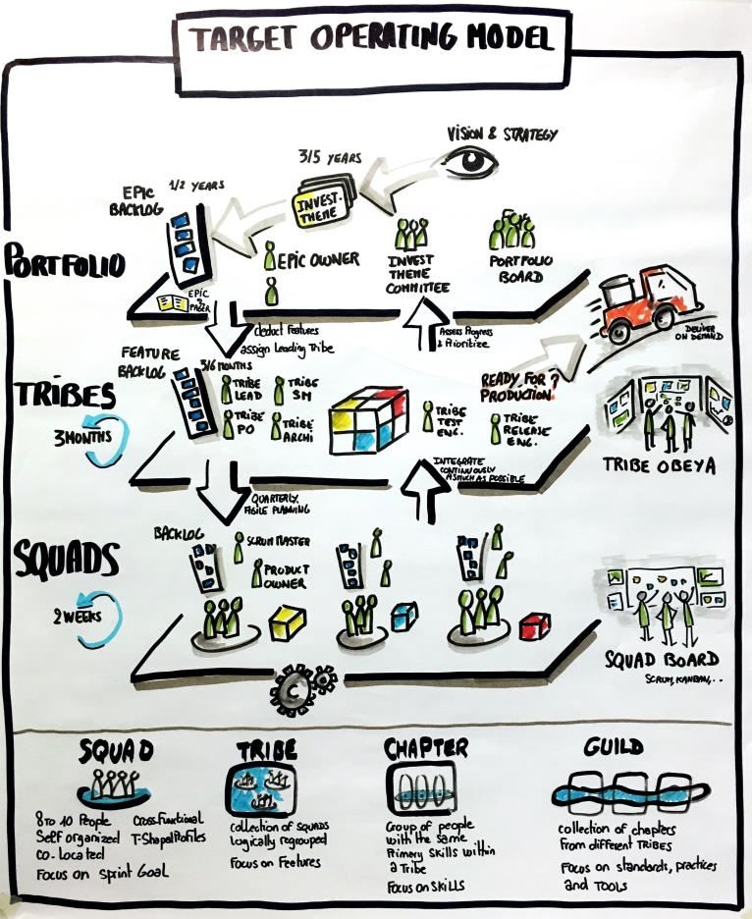
The model
Notes:
Target operating model (TOM) is a description of the desired state of the operating model of an organisation. When working on the operating model, it is normal to define the "as is" model and the "to be" model.

Slide 30
3 phases, 3 months each:
Preparation
Execution
Sustain
Notes:
Number of coaches, number of people coached, number of tribes

Slide 31
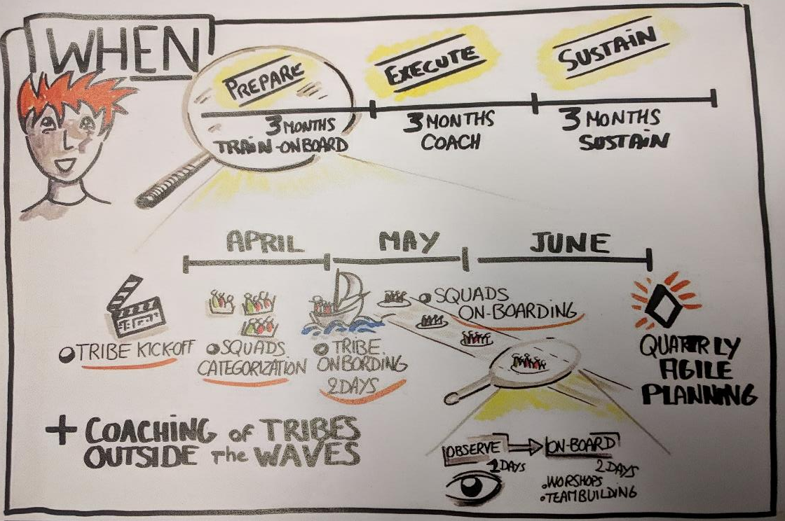

Slide 32
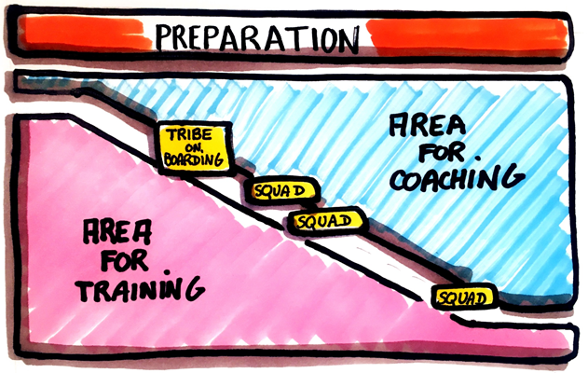
Preparation

Slide 33
Execution
Coaching on the “shop floor”
Implementing Scrum or Kanban
Shu Ra Ri
Facilitating Scrum ceremonies ourselves
Feedback sessions
…

Slide 34
Sustain
Part of the coaches leave
Agile maturity assessment is one of the indicators of the autonomy of the Squad
Experienced Scrum Master as well
Tribe Scrum Masters, mainly, should become the coaches.
Fostering the agile and lean mindset and keeping the mentoring and coaching activities

Slide 35
Planning the quarter
PIP
Program Increment Planning
Notes:
Number of coaches, number of people coached, number of tribes

Slide 36
PIP - Floor Plan

Slide 37
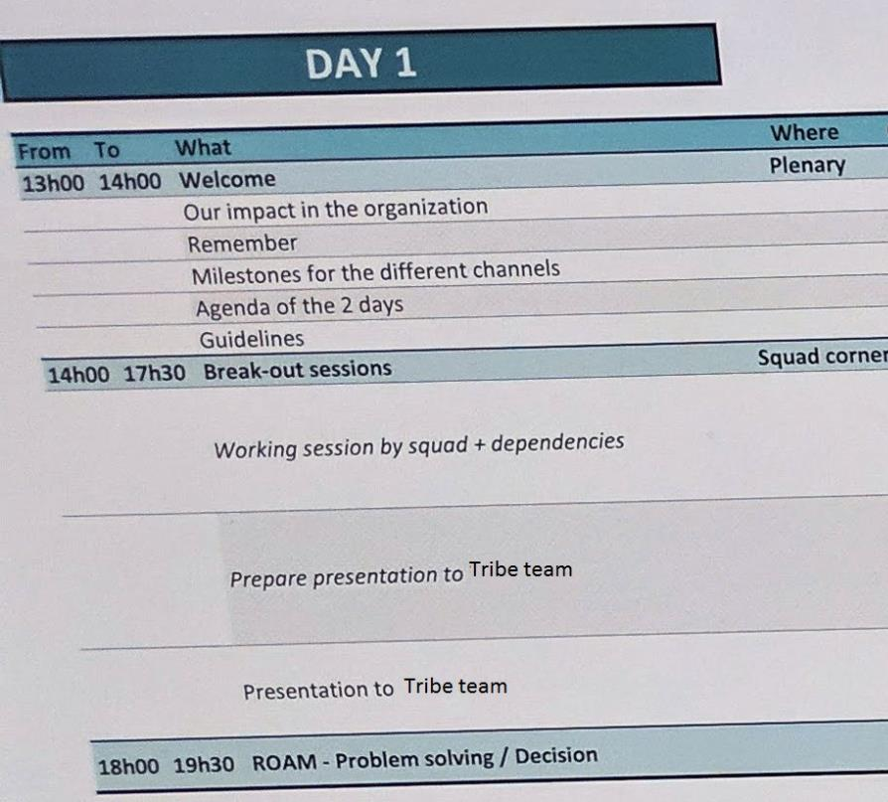
PIP – Agenda

Slide 38
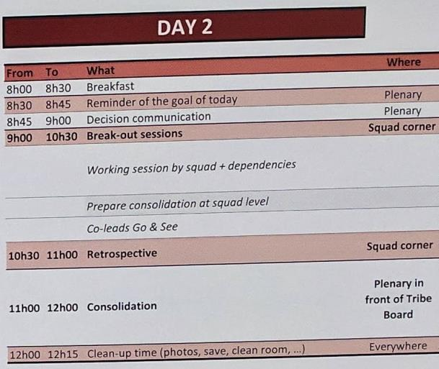
PIP – Agenda

Slide 39
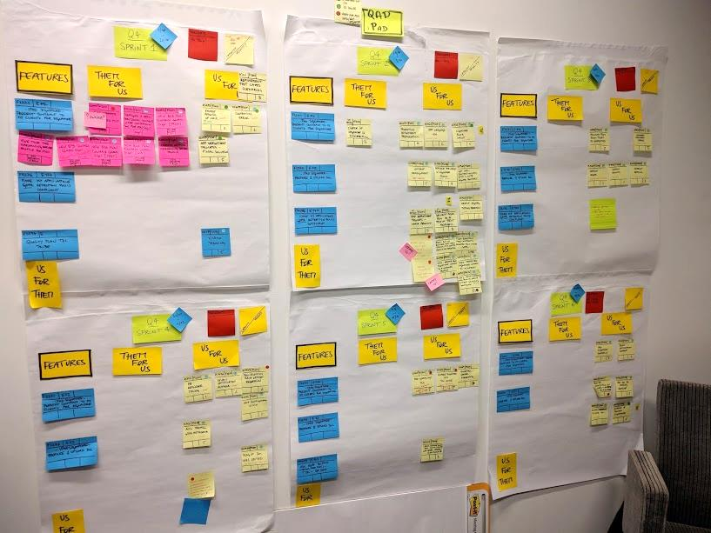

Slide 40
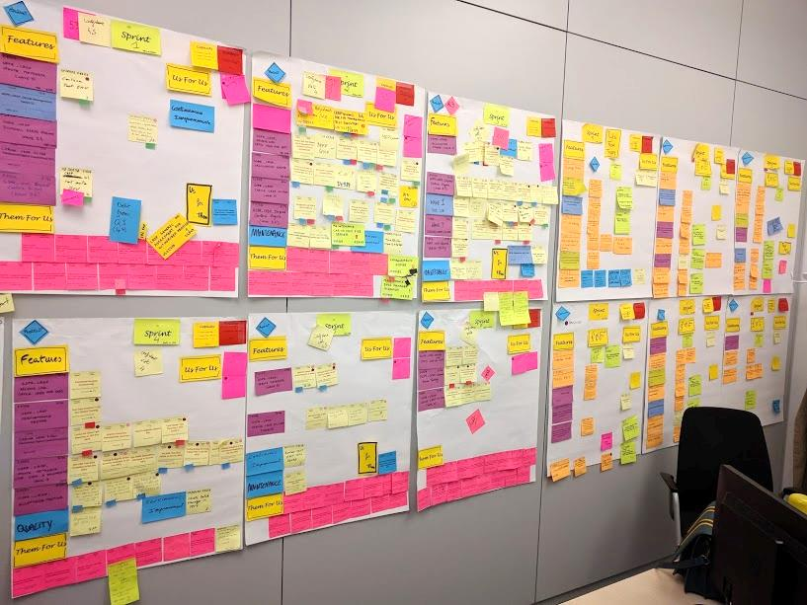

Slide 41
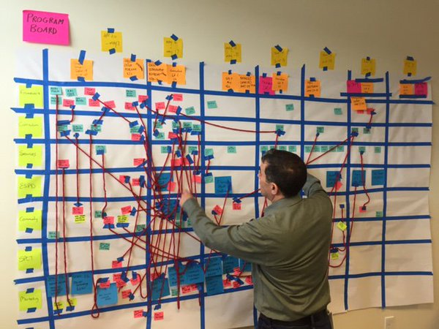
PIP - Example of a board (not that simple)

Slide 42
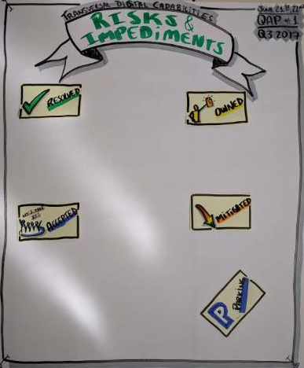
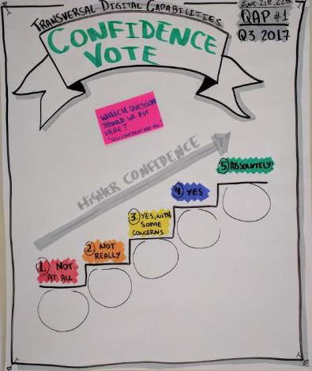
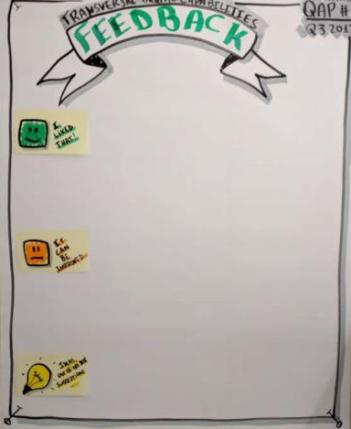
PIP – Other artifacts

Slide 43
PIP – Improvement it

Slide 44
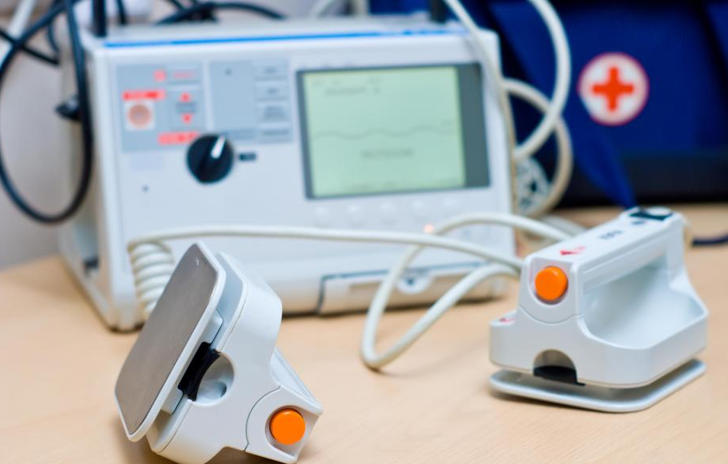
PIP – Not joking...

Slide 45
Tribe Team
Dynamics
Notes:
TEAM
GO AND SEE

Slide 46
Assessing the maturity
Notes:
Very good tool as input. Not a bible.
What it is
How it is used

Slide 47
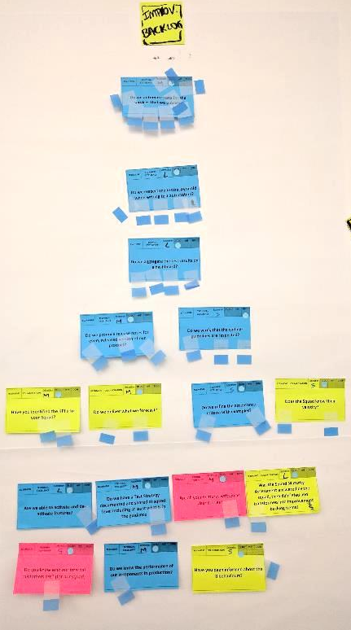
Agile maturity assessment

Slide 48
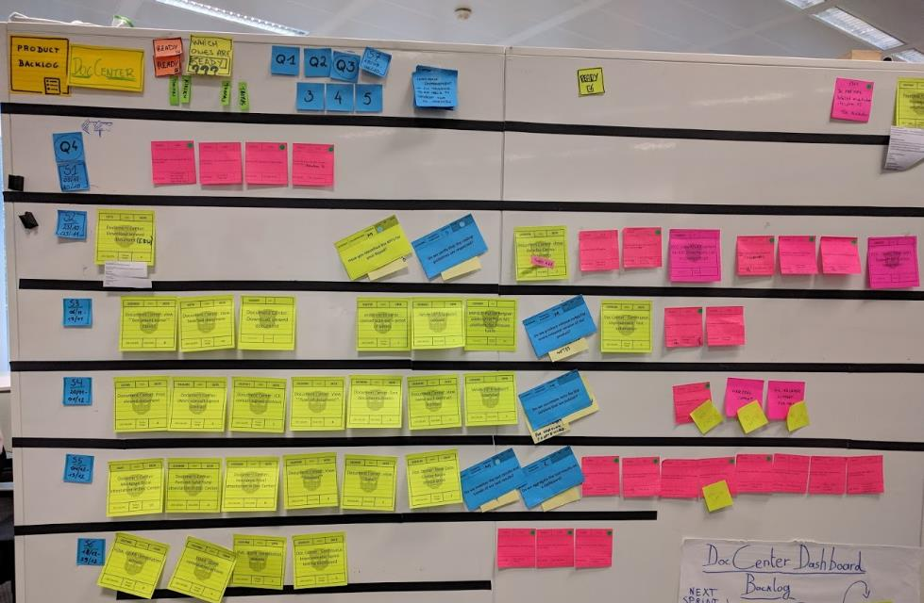
Agile maturity assessment

Slide 49
Speaking about
model and assessment...
Bonus:
Satir Change Model
Light assessment
Notes:
Number of coaches, number of people coached, number of tribes

Slide 50
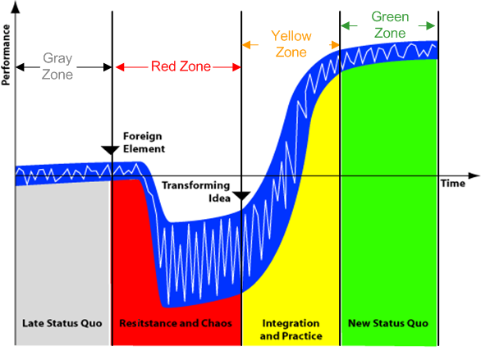
Satir Change Model – Light assessment

Slide 51
Satir Change Model - Questions
In your opinion, where do you think we are now?
From 1 to 5, how confident are you that we will reach a better status quo than we were before the transformation?
What is missing for you to vote 5? (if you voted 5, how to make it 6, 7…10? ☺)

Slide 52
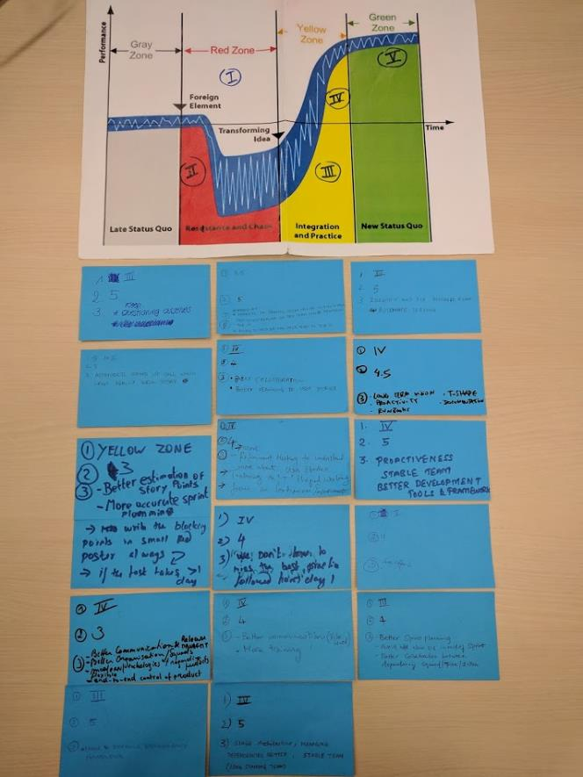
Satir Change Model – Results

Slide 53
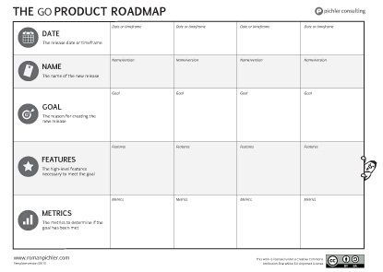
Assessment – Satir Change Model (14 members)
1. In your opinion, where are we now?
8
5
1
2. From 1 to 5, how confident are you that we will reach a better status quo than we were before the agile transformation?
I: II: III: 3 IV: 9 V: 2 Average: 4
3. What is missing for you to vote 5? (if you voted 5, how to make it 6, 7…10? ☺)
Dependencies solved faster/easier, more T-shape, more discipline, etc...

Slide 54
Successes,
Points for improvement
&
Challenges
Notes:
-

Slide 55
Successes
Strong sponsorship, top-down approach
Strong sponsorship = more budget (trainings, logistics, postits…)
Anti-patterns and behaviours on the spotlight
Tribe team

Slide 56
Tribe team

Slide 57
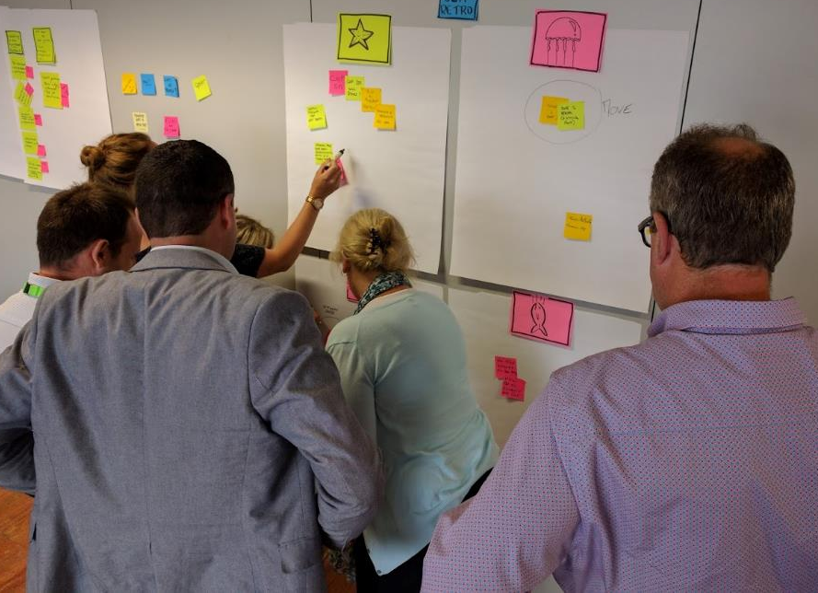
Tribe team

Slide 58
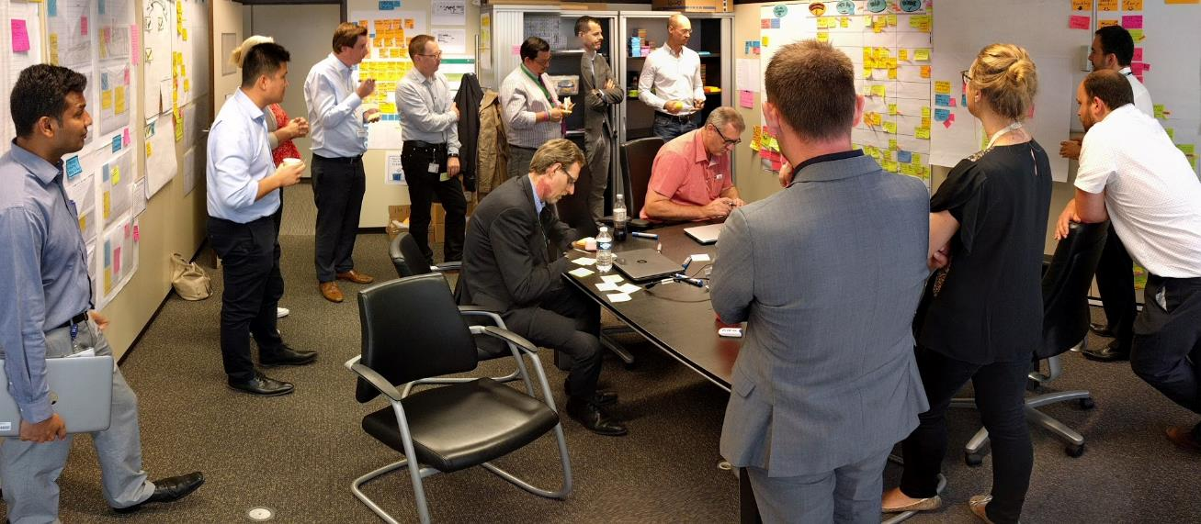
Tribe team

Slide 59
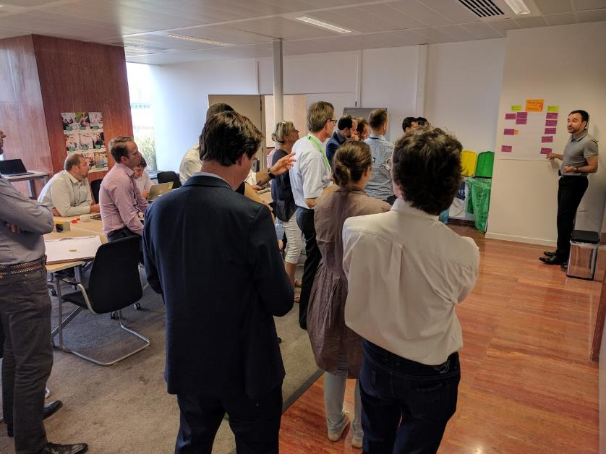
Tribe team

Slide 60
Successes
Strong sponsorship, top-down approach
Strong sponsorship = more budget (mandatory agile trainings)
Smile, you are on the spotlight
Tribe team
Gemba walk (Go & See)

Slide 61
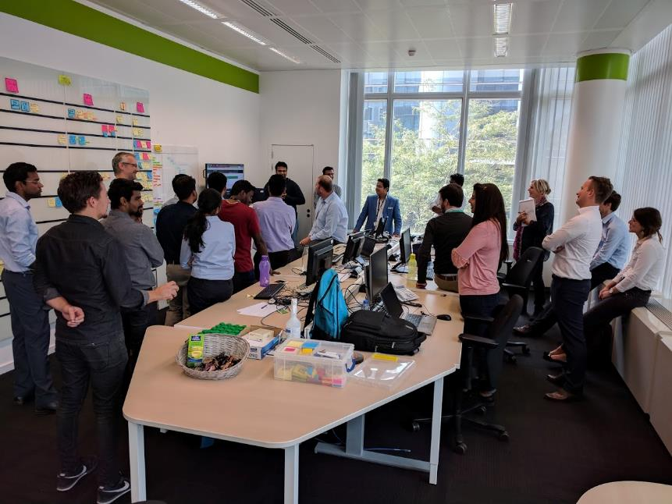
Go & See

Slide 62
Successes
Strong sponsorship, top-down approach
Strong sponsorship = more budget (mandatory agile trainings)
Smile, you are on the spotlight
Tribe team
Go & See
20% of capacity to Continuous Improvement! No excuses.
Coaches Squad
Huge transparency!
More fun! ☺

Slide 63
Successes - Testimonials
Tribe lead, during PIP: “Big thanks for the transparency. We know now where we can help, what's in danger or not, what’s the forecast in a clearer way.“
Key business stakeholder: “It’s way more transparent! We have POs from business in the Squads. We have the PIP where the alignment is huge! We can easily check in the tool the forecast of each squad. We can align and take decisions together, and be prepared before the problem happens, which was not the case before.”
Chapter leader: “I’m from a strong waterfall background. 20 years. And I would never come back to the old ways.”
Notes:
Of course there are many others not very delighted too

Slide 64
Points for improvement
Split of the tribes
The maturity assessment frequency
Same person, multiple hats
Training for the leaders

Slide 65
Challenges
Split of the tribes
Managing dependencies
Already identified as a major challenge/slowing factor
Portifolio prioritization (too many epics!)
Regulatory/legal
Getting features ready
Front-end split
Alignment of all the coaches: same message
Resistant people (surprise!)

Slide 66
So...
Is
“SpotiSAFeLeSS”
an established
agile approach?
Notes:
No. It’s not even an official model.
But the way it was done, might be: consider the reality of the organization and what are the problems we want to solve and where we want to go.
Then choose what suits you best! Maybe SAFe? Maybe LeSS? Maybe Spotify? Or maybe what suits you best from each!

Slide 67
Thank you!
☺

Slide 68
Questions?

Slide 69
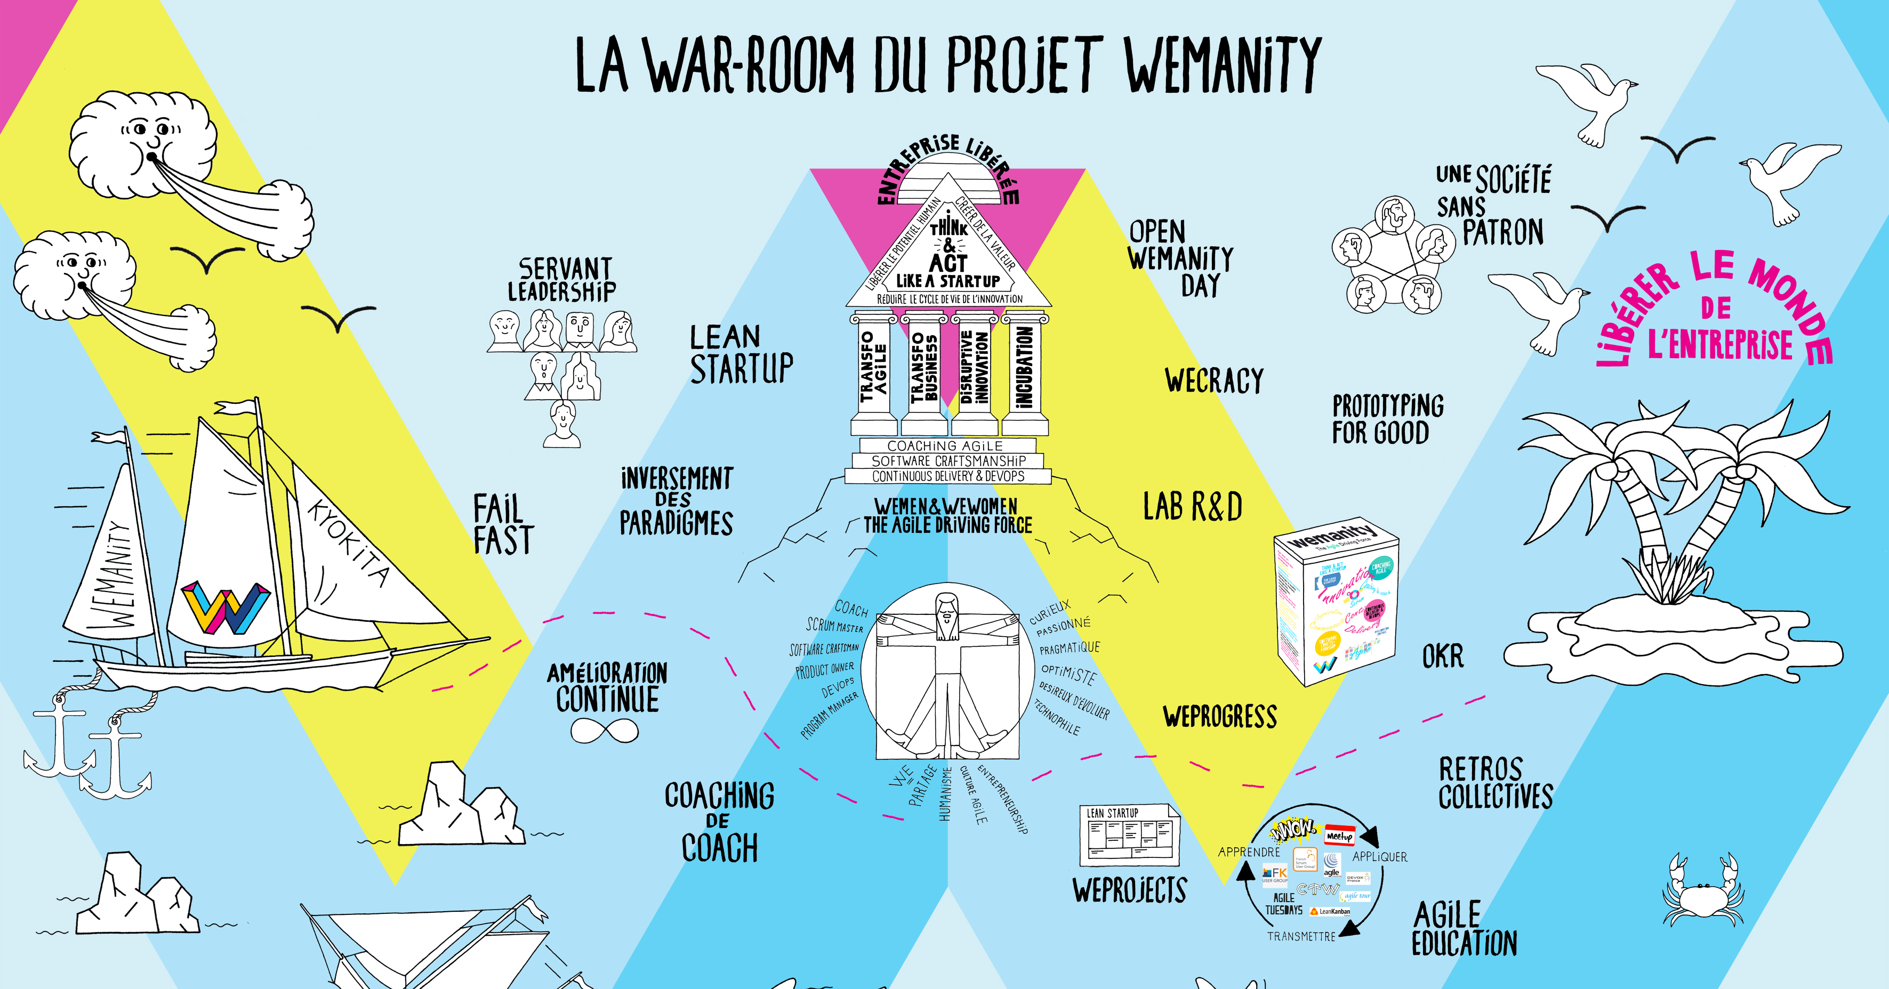
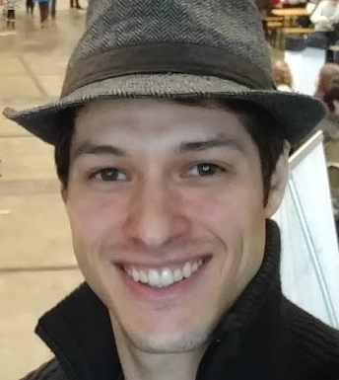
Thank you!
Artur Margonari
Agile coach, Trainer and Facilitator
Email: amargonari@wemanity.com
Twitter: arturmargonari
Mobile: +32 483 71 87 64

Slide 70
Notes:
If I could inspire at least one of you here, that would be nice.

Slide 71
Notes:
But if I could give some ideas and inspiration to the majority, I would be even happier! ☺

Slide 72
Take aways
2 minutes
Notes:
Number of coaches, number of people coached, number of tribes

