Slide 2
Doing I.T. for SCIENCE!
Sprints, Startups and the Scientific Method
@dylanbeattie
#trega16
Notes:
Good afternoon Tampere! My name is Dylan Beattie. I'm a software developer and systems architect, I've been building websites since 1992 and managing software teams for the last ten years, and today, in keeping with the theme of experimentation for Tampere Goes Agile 2016, I'm going to talk to you about SCIENCE.

Slide 3
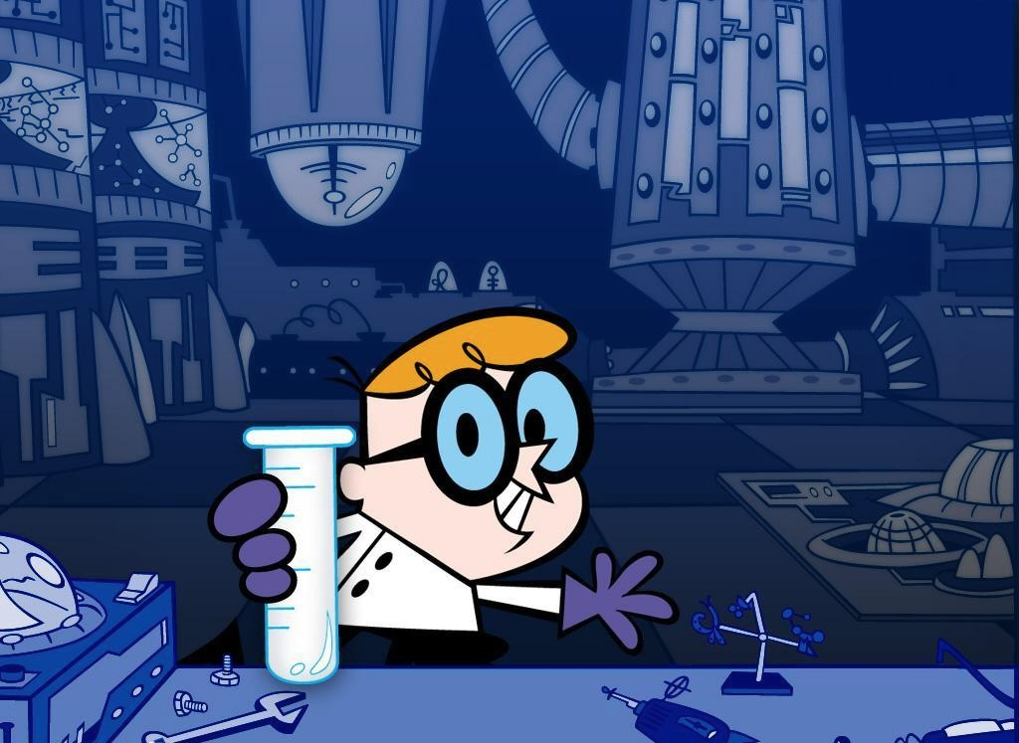
http://dexterslab.wikia.com/wiki/Dexter's_Laboratory_(location)
Notes:
See, the relationship between computers and science has always been complex. Fifty years ago, if you were doing any computing at all, you'd be spending most of your time doing old-fashioned science with pencils and slide rules, because computers were incredibly rare, specialist devices and they basically took a full-time team of scientists and engineers just to keep them running, let alone make them do any useful work.

Slide 4
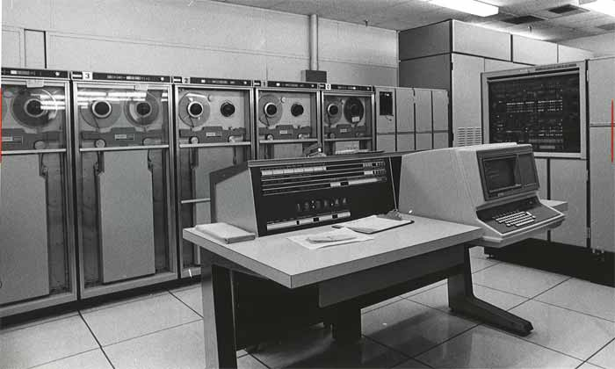
https://upload.wikimedia.org/wikipedia/en/5/54/UnivacII.jpg
Notes:
You'd be spending time thinking about circuit designs, vacuum tubes, drum memory and machine code instructions, and if you got those bits right, at the end of the day you could actually run your program.
Today, that model is completely inverted - computer programs and computer simulation is a fundamental part of most modern scientific research.

Slide 5
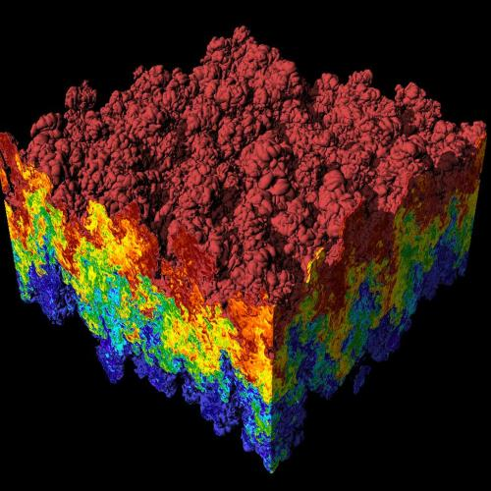
https://commons.wikimedia.org/wiki/File:Rayleigh-Taylor_instability.jpg
Notes:
We simulate black holes, nuclear reactions and cancer cells - and the machines we use to do it, even the smartphones in our pockets, are designed using software so sophisticated that nobody really understands it all the way down. As software developers, we work at the top of a rich, rich set of abstractions - our APIs and frameworks sit on top of compilers, which sit on top of operating system calls, which sit on top of abstract hardware interfaces and device drivers... but if you keep going down far enough, right at the bottom of the stack, there's physics.
Then there's what we call "computer science" - the study of data structures, algorithms.

Slide 6
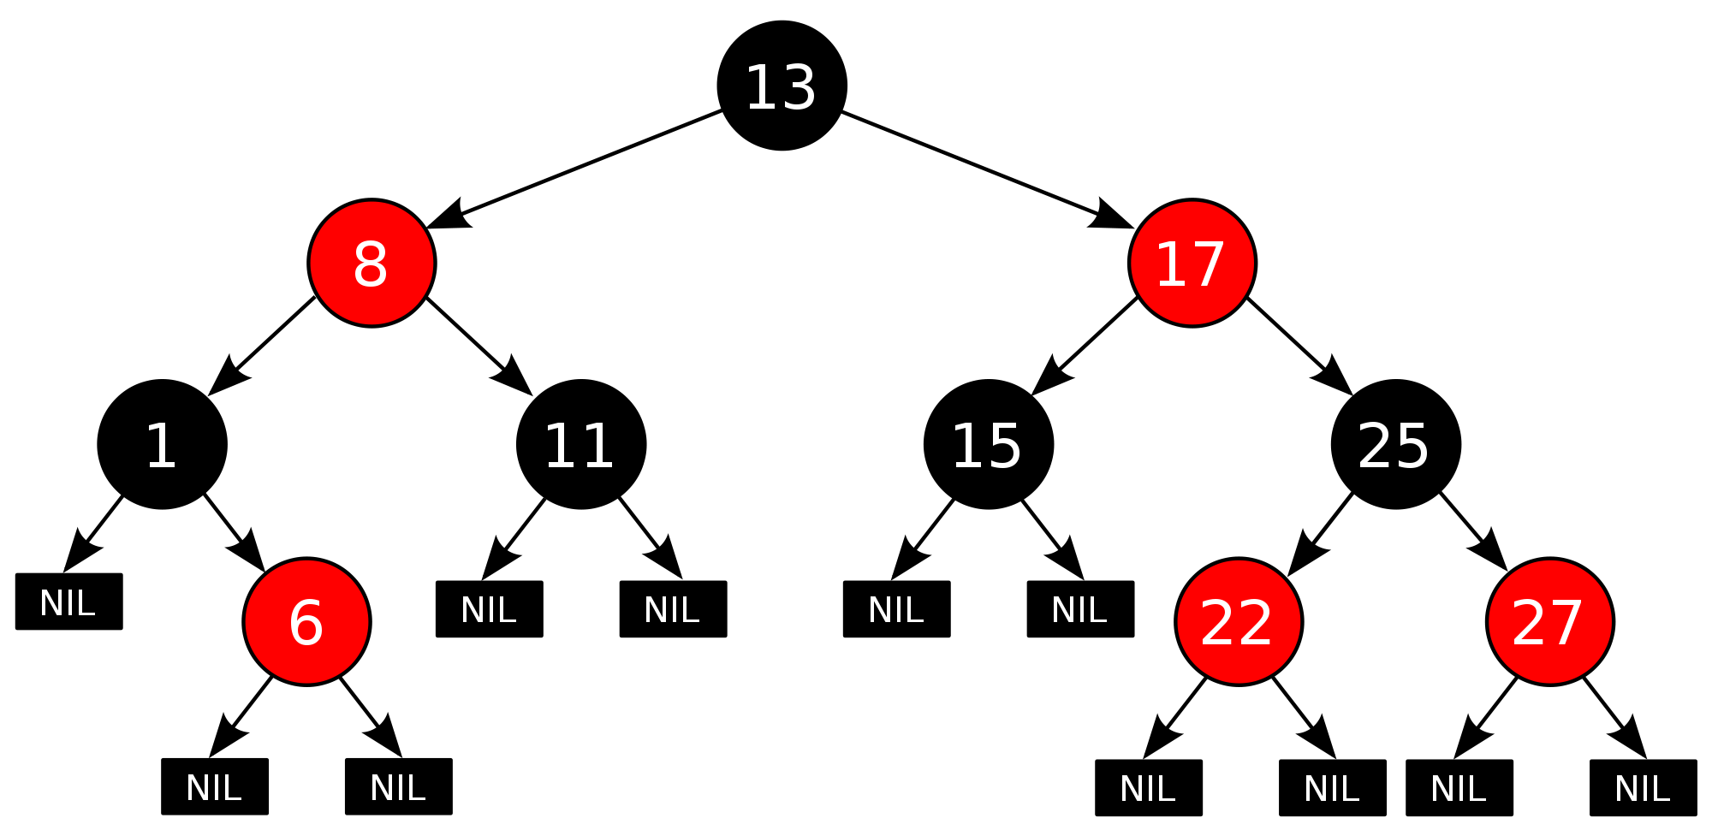
https://commons.wikimedia.org/wiki/File:Red-black_tree_example.svg
Notes:
I spent three years doing this at University - I got a degree and everything, which means I'm officially a scientist. But you know, the funny thing is that during my three years studying "computer science", I wrote a lot of code and I found a lot of bugs, but I don't think I did a single experiment or validated a single hypothesis, because when you get right down to it, what we actually do isn't science, it's engineering. We don't talk about hypotheses and experimental error - we talk about frameworks and pipelines. We have people called architects, and we talk about build processes and modules. We even have a conference called BuildStuff. Now, it just happens that whilst I was at university studying computer science, I had a holiday job working for a real engineering company - Arup.

Slide 7
https://commons.wikimedia.org/wiki/File:The_Sydney_Opera_House_at_dusk.jpg
Notes:
I was mainly installing Novell PerfectOffice and setting up HP Laserjet printers, but I did get to spend a lot of time chatting to structural engineers and building engineers, and I've spent a lot of the intervening years reflecting on those conversations.
See, as much as we delude ourselves, software engineering is not like building engineering, and building a software application is nothing like building a - well, like building a building. Or a bridge, or a house, or a motorway.

Slide 8
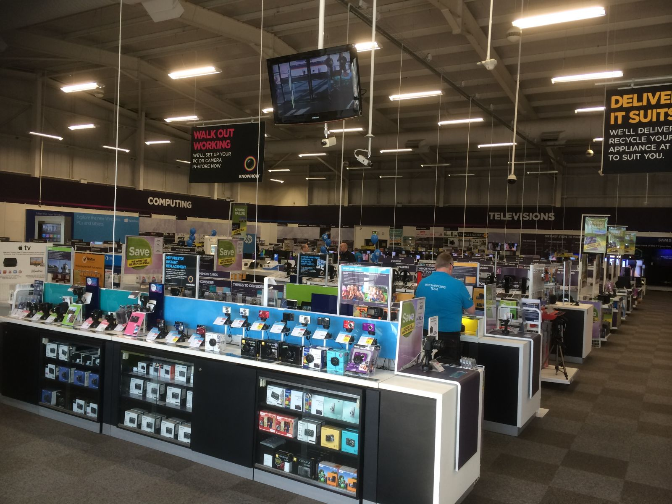
http://www.retaildesignworld.com/single-page/533580c73c5dc-currys-pc-world-refurbishments-bring-new-services-in-store
Notes:
Imagine somebody walks into a computer store and says "hey, I need a word processor." And the store owner says "wow. Well, OK. First we're going to need to capture your requirements. Then we'll put a bid out to tender, get a couple of different software houses to submit a proposal for how they might write a word processor for you. Microstar are pretty good; they've built quite a few word processors so they can probably get you something by the end of next year. Or you might be able to pick up a second-hand word-processor from somebody who's not using theirs any more."
Crazy, right? We don't do that. We just download Microsoft Word. And that's the critical difference - if you need a suspension bridge, or a power station, you can't just download one that's already been built. And it's not just construction engineering.

Slide 9
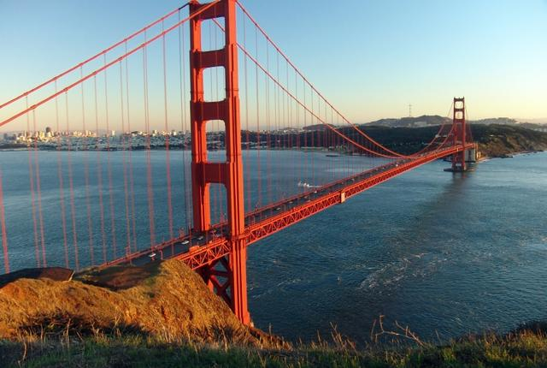
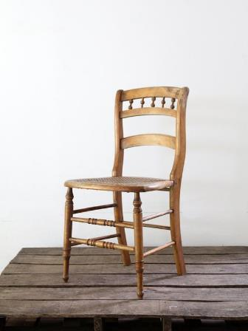
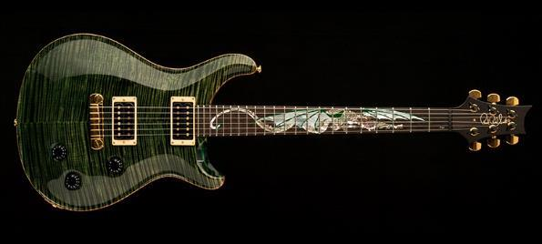
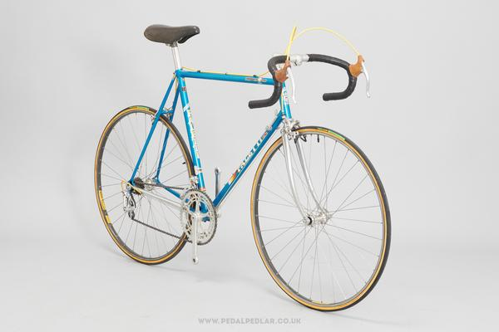
https://uk.pinterest.com/pin/73676143875042982/
http://www.prsguitars.com/30/img/dragon2.jpg
http://www.pedalpedlar.co.uk/collections/vintage-bikes
http://mentalfloss.com/article/64379/20-awesome-facts-about-golden-gate-bridge
Notes:
Furniture. Musical instruments. Bicycles - they're all built by people who have built them before. We have a word in English - masterpiece. A masterpiece was the piece of work produced by an apprentice aspiring to become a master craftsman - built by somebody who had built the same thing dozens, maybe hundreds of times before. Every piece of work is unique - and by the time the apprentice becomes a master, they know every single detail, every step of the process. They just don't make mistakes any more.

Slide 10
Notes:
Think about the last software project you built. Imagine that, right now, you had to do it again - your source code is gone, your backups are gone, GitHub has been hacked by evil wizards who hate you and, just to cap it off, you've spilled vodka all over your laptop. So you start again. You work on it all week - and then on Friday night, it all goes away AGAIN! Source code, backups, Git repositories... Imagine this happened every week. Within a couple of months, you'd get really, really good at building that one software application, right?

Slide 11
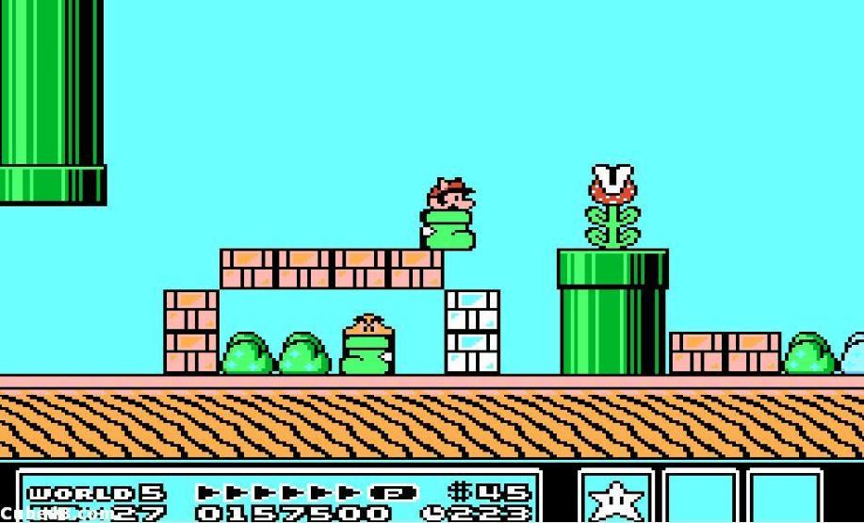
Notes:
It'd be like learning Super Mario World all over again - it'd get to the point where you could write thousands of lines of code without making a mistake. We have something kinda like that - a thing called a code kata - anybody ever been to one? You work on a problem for half an hour, then you delete your code and start again, and again, and again - and by the end of the evening, you're REALLY REALLY GOOD at writing FizzBuzz, or Fibonacci, or some similarly trivial program.

Slide 12
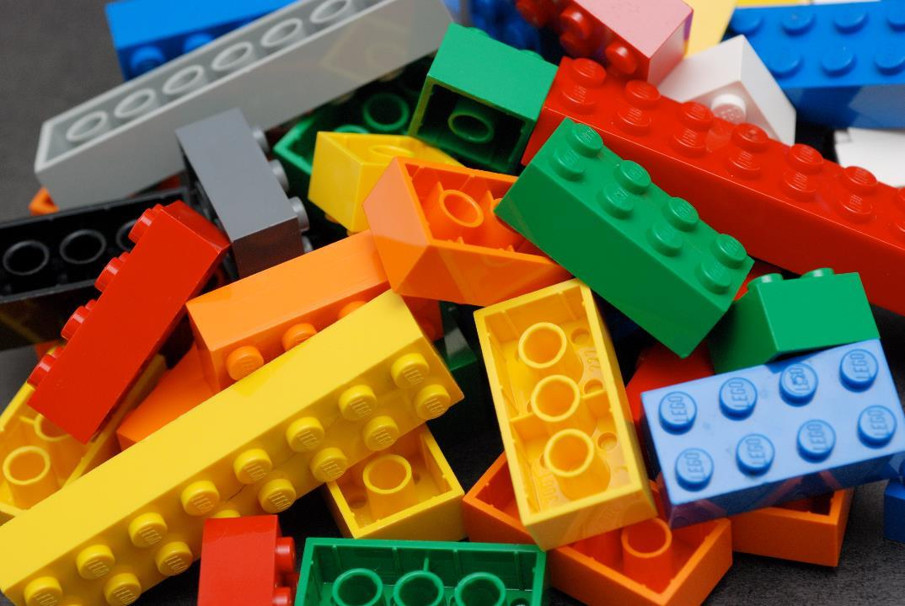
Notes:
But for real projects, we can't do that, because we're expected to re-use the solutions that have already been created. This ability to re-use existing components is one of the most amazing things about software - we have string libraries, crypto libraries, modules, frameworks, even entire applications that we can just install, plug in and start using. In theory, we never have to solve the same problem twice.
But there's a dark side to this reusability. See, all the code you know how to write has already been written, and all the problems you know how to solve - they've already been solved.

Slide 13
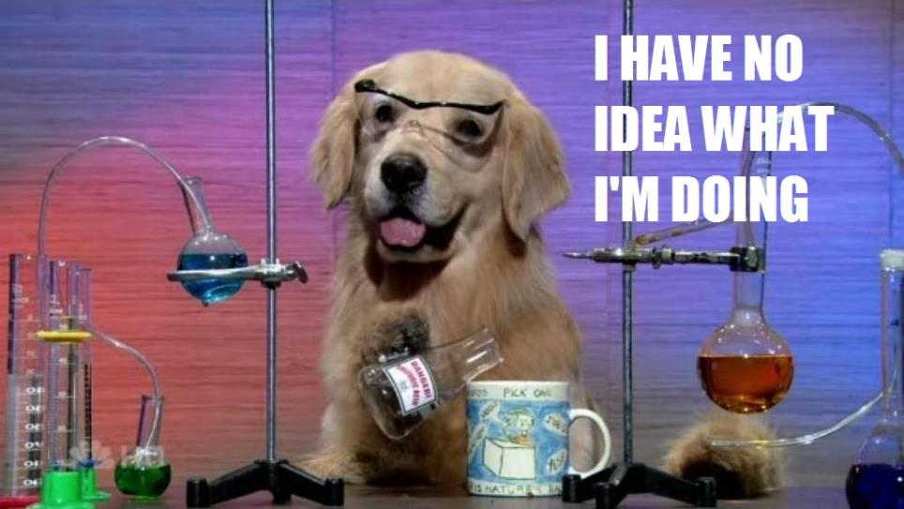
http://i3.kym-cdn.com/photos/images/original/000/234/739/fa5.jpg
Notes:
Which means that when any sufficiently accomplished programmer actually writes some code, they do not know what they are doing. Most of the time, what we're doing isn't actually engineering - it's exploration and invention. And that phenomenon goes all the way up. It's not just our methods and modules that are innovative - it's entire companies. Startups exist because entrepreneurs saw a chance to solve a problem nobody had solved before - sure, people understand the mechanical process of starting a company and launching a product; we talk about MVPs and venture capital and round 2 funding, but whether it's writing code or launching startups, we do not know what is going to work. And yet, a lot of the time, it does - and the reason it does is that we are actually all scientists, and we're all doing experiments, all the time - and although we probably don't realise it, we are applying something called the scientific method.

Slide 14
The Scientific Method
Notes:
The scientific method is a body of techniques for investigating phenomena, acquiring new knowledge, and correcting or integrating previous knowledge. It forms the basis of almost all experimental science - everything from Isaac Newton to the Large Hadron Collider. It is the toolbox that humankind has used to study and understand our universe, and it's also a really neat way to build software - and here's how it works.
It breaks down into six basic steps:

Slide 15
Observation
Hypothesis
Prediction
Experiment
Analysis
Communication
Notes:
First: observation. Look at what's going on. Observe the problem. Look at the system you're trying to understand. Read what other people have written about it.
Second: hypothesis. You come up with one possible explanation for the behaviour that you're seeing.
Third: Prediction: Based on your hypothesis, you make a prediction about what you think will happen.
Fourth: Experiment. You design an experiment that will test your prediction.
Five: Analysis. Conduct your experiment, gather and interpet data. Was your prediction correct?
Six: Communicate. Publish. Share your method and your results.
OK, let's look at an example. We're going to start with observation. Observation is a constant, ongoing process, and it's not just scientists who do this - everybody does this. We humans are naturally curious creatures - anyone here got kids? "Daddy, why is the sky blue?" "Daddy, why does it rain?" "Daddy, how does a rainbow work?" Well? - do you know how rainbows work?

Slide 16
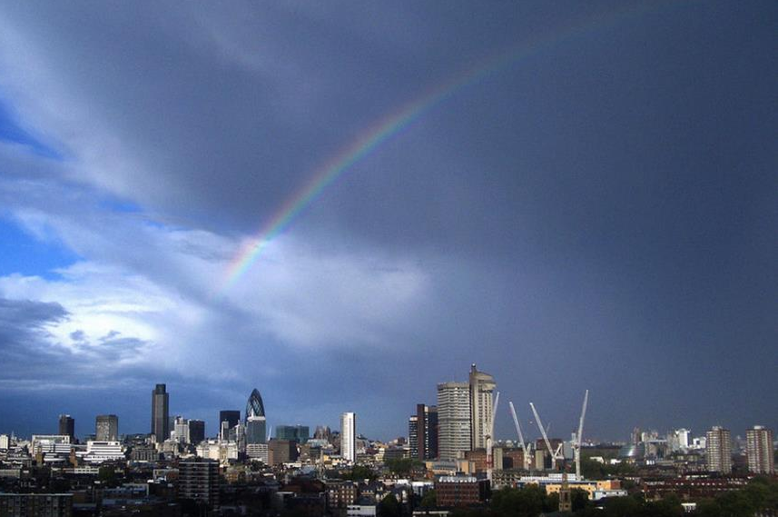
https://www.flickr.com/photos/dylanbeattie/30310047312/
Notes:
OK, so we've done our observation, and we're curious. We've got a question to answer - "how do rainbows work?"
The next step in our process is to formulate a hypothesis - a possible explanation for your observations. Throughout history, there's been all sorts of wonderful theories about rainbows. Some cultures claimed the rainbow was an actual bow, used by the gods to shoot arrows of thunder and lightning. Some believed the rainbow was the hem of the sun god's cloak; some believed it was the bridge that connected Earth to the heavens.
And then there's this chap -

Slide 17
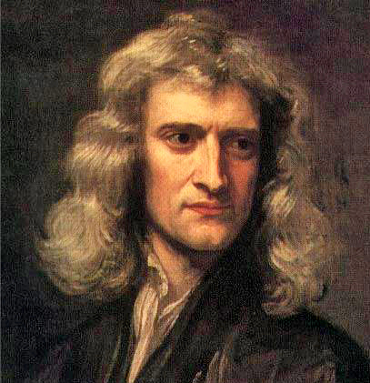
https://commons.wikimedia.org/wiki/File:GodfreyKneller-IsaacNewton-1689.jpg
Notes:
Sir Isaac Newton. Like most other people, Newton had observed the colours of the rainbow, but - despite the fact he was actually a deeply religious man - Newton suspected that the colours of the rainbow had nothing to do with gods, but were instead caused by some previously undiscovered property of sunlight. At the time, the accepted dogma was that sunlight was "pure" - that light worked a bit like paint; you started out with pure, unsullied, heavenly white light, and to make coloured light you had to take white light and add colour to it.
Newton had a different idea. The story goes that he'd seen a peddler selling glass prisms at a country fair, and noticed the rainbow patterns created by sunlight shining through the prisms - we don't know whether that part's true, but we do know that before long, Newton had formulated a hypothesis about the nature of light.

Slide 18
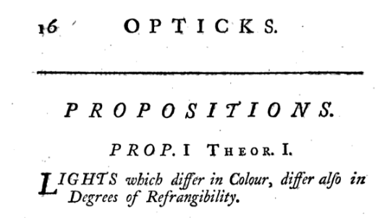
https://books.google.co.uk/books?id=GnAFAAAAQAAJ
Notes:
"Lights which differ in colour differ also in degrees of refrangibility"
https://books.google.co.uk/books?id=GnAFAAAAQAAJ&pg=PA16#v=onepage&q&f=false
"The light of the sun consists of rays differently refrangible"
https://books.google.co.uk/books?id=GnAFAAAAQAAJ&pg=PA21#v=onepage&q&f=false
Now, the next step in the scientific method is a prediction - something you can actually test. Newton's prediction was that if you hold a glass prism - like this one here - in front of a beam of sunlight, it'll split that beam of "pure" white sunlight into rays of different colours - and that if you used a second prism to combine the coloured rays back together, you'd end up with the original white light again.

Slide 19
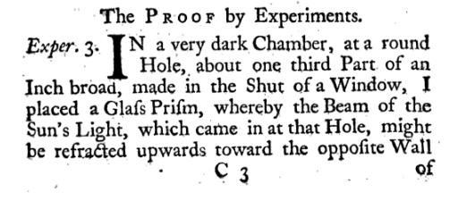
Notes:
Next, the experiment itself - Newton, choosing a bright sunny day, making a tiny hole in the shutter of his rooms at Cambridge, letting the sun shine through his glass prisms onto a white wall, and studying the patterns that appeared. of course, there were no cameras around in 1676, so we don't have any visual record of what Newton actually saw - but because he published his method, thousands of people have repeated his experiment over the years, and so we can see for ourselves exactly what Newton saw that day.

Slide 20
Notes:
In fact, we can see it much more clearly, because we have much higher-quality prisms today than Newton did.
So - we've done our experiment, and we've gathered some data. The next step is analysis: was our prediction correct? Does our data support our hypothesis? If we're lucky, the answer is a resounding "yes" - but not always. History doesn't tell us how many wrong hypotheses Newton went through before he arrived at the right one - but just because an experiment didn't produce the 'right' answer doesn't mean it wasn't useful. Finally, communication

Slide 21
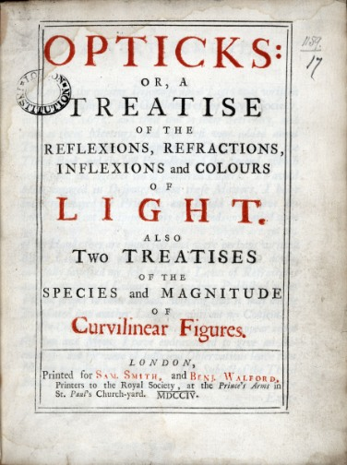
http://www.kingscollections.org/media/exh_spc/images/007018/opticksn.jpg
Notes:
In Newton's case, he reported his findings to the Royal Society of London, although he didn't actually publish his masterpiece book on Opticks for nearly thirty years.
But he was right, and Newton's work on light and optics has become part of every science curriculum in the world. Communication, publication, this willingness to share results, is every bit as important as the rest of the process, because it allows each generation to build on work that's already been done. As Newton himself said, "If I have seen further it is by standing on the sholders [sic] of Giants.“
OK, so fast-forward a dozen generations. Anybody here got a smartphone in their pocket? With a camera? Newton's work on optics. Colour screen? Newton's work on reflection and refraction. Accelerometer? Newton's work on gravitation. He didn't invent these things, of course - but he published his research, and generations of scientists and inventors have expanded on that research, and in turn have published their own results, and it's thanks to them that we all have these amazing high-definition supercomputers in our pockets.

Slide 22
Notes:
OK, so that's the scientific method - but what does any of this have to do with agile software development? Well... actually, quite a lot. See, as I was saying earlier, we software engineers actually spend a great deal of time doing experiments - but we're not always conscious that that's what we're doing, and maybe if we were, we could do them better.

Slide 23
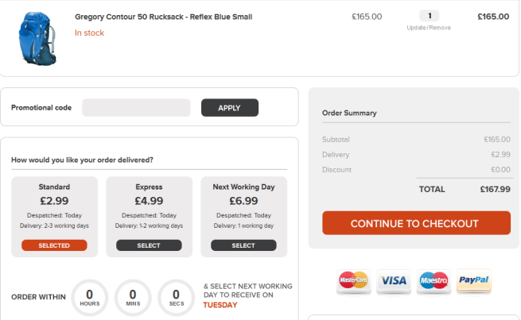
http://ecommerce-platforms.com/ecommerce-selling-advice/12-e-commerce-sites-inspirational-checkouts
Notes:
OK, so here's an example. Let's start with an observation: you're running an e-commerce website; you've got a catalogue of amazing products, and you've noticed that recently, a lot of your customers get as far as the checkout screen and then abandon their shopping cart. You're not sure why - all you know is that they're logging in, they're selecting some products, they're creating an account, but then they're not actually paying for anything.
So you're having a meeting with your marketing team to try and work out what's going on, and one of your senior marketing people - we'll call him Dave - comes up with a hypothesis. "It's the new checkout page. I told you your design sucked. We never had this problem with the checkout page on the old website."
And now there's a massive argument - because everyone knows Dave hates the latest redesign of the checkout page.

Slide 24
Observation
Hypothesis
Prediction
Experiment
Analysis
Communication
Notes:
But what if, instead of an argument, we did an experiment? We're going to do something called A/B testing, and here's how it works:
First: the hypothesis: "people don't like the new checkout page design and that's why they're not completing their orders"
Second, the prediction: "If we reinstate the old checkout page, we will see more customers completing their orders."
Next, we design the experiment: We'll split our website visitors into two groups - A and B. We'll do this completely at random, we'll use a cookie to keep track of who's in which group. When they place an order, we'll send everybody in group A to the new checkout page, and everyone in group B to the OLD checkout page. If the prediction is correct, we should see more abandoned shopping carts in group A, and more completed orders in group B"
So - you make some changes to your website code, run it like this for a week so you've got a decent sample size, and then you analyse the data. And it turns out Jeff's wrong - you're getting just as many abandoned orders from the old website as you are from the new website.
OK, so now you communicate this to the rest of your team - you haven't solved the problem, but at least Jeff's shut up about the website redesign now. So you need a fresh hypothesis.. and that's when one of your dev team says "hey, I saw a thing on Twitter about our payment provider having problems with the latest Firefox certificate update - maybe that's affecting what we're doing?"

Slide 25
Observation
Hypothesis
Prediction
Experiment
Analysis
Communication
Notes:
OK, this is another good observation - so let's create a hypothesis : "we're getting abandoned shopping carts because people running Mozilla Firefox are having problems placing orders via our live website, and we didnt' pick it up in testing because our test environment doesn't talk to our payment provider".
So - somebody turn this into a prediction. "I think if we try to place an order on the live website using Firefox, we'll find that we can't enter payment details"
Now this is an easy experiment to run - you install Firefox, go to your own website, and try to buy something. And, sure enough, you end up with this. Just to be sure, you try the whole checkout process on several different machines, and using several different browsers - and there you go. That's data, and when we analyze it, we see that sure enough, nobody has managed to place an order using Firefox, and in every case they've got as far as the credit card checkout form and then had a browser error that means they can't go any further.
Finally, you communicate it - probably by posting on Twitter and writing a blog post about how AutoPay PLC are awful because they don't support the latest Firefox root certificate update and what are they going to do about it? - and you're done.

Slide 26
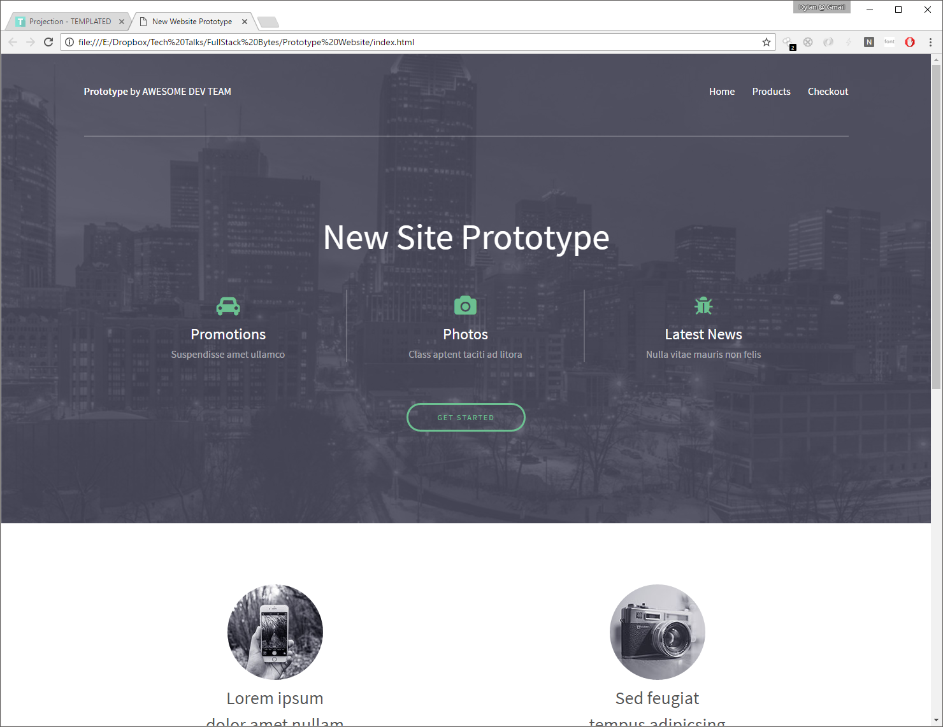
CSS template by https://templated.co/projection
Notes:
Except you're not done, of course, because you're still getting abandoned shopping carts - and that brings us on to another fundamental point about the relationship between experiments and software development: the experiment is not the solution. Experiments are about discovery, and not about implementation.
How many of you have ever had this conversation? You're talking to a client - maybe it's your boss, maybe it's a customer - and you're showing them a prototype.
And you say "um... hang on... this isn't real... this is just a prototype" - but to them, it looks real. It's running on a computer, and it's got clickable buttons and everything. When you explain that it's going to take another four weeks - or maybe even longer - to develop your prototype into a real application, they generally look a bit unhappy.
See, that kind of rapid prototyping is another kind of experiment - but all too often, we create prototypes as a routine part of our development process, and then we get into all sorts of awkward conversations about how a prototype isn't the same as a finished product.
Now, there's two ways we can deal with this particular problem. One is that we make our experiments more obvious. If you're building prototypes, don't make them look anything like the actual product you're trying to deliver.

Slide 27
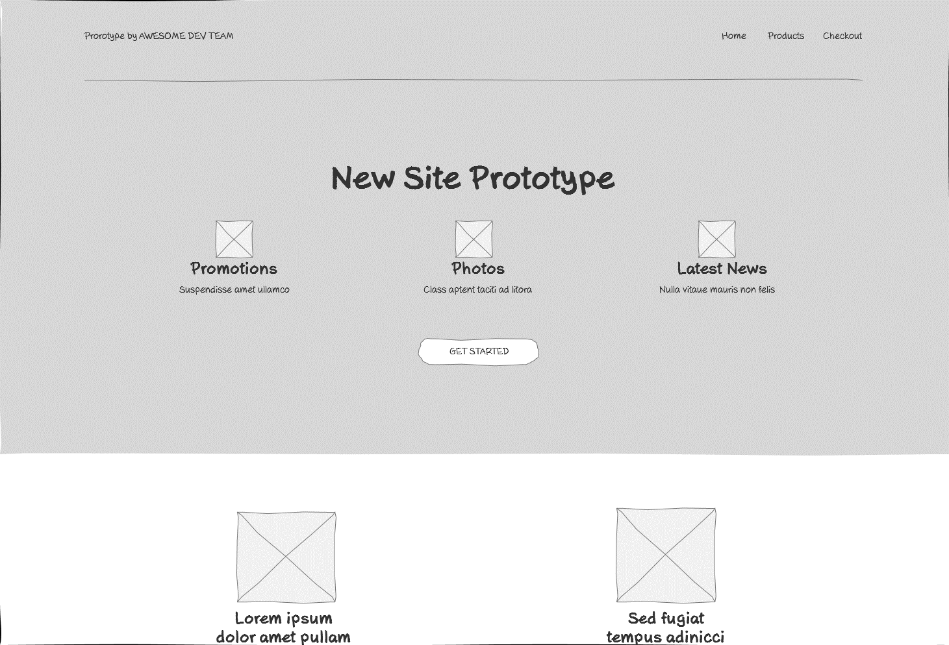
CSS template by https://templated.co/projection
Notes:
There's a tool I used for UI prototyping called Axure RP, and one of the things I love about Axure is that it'll export your prototypes as HTML using a sort of "pencil sketch" theme - you get clickable, interactive prototypes that literally look like someone's sketched them on the back of a napkin. Nobody ever looks at one of those prototypes and asks when it's going to go live - it's very clearly part of a design and discover process as opposed to actual implementation. Some designers use an approach called grey box design for the same thing - a way to present ideas and get feedback - DATA - that isn't going to be mistaken for a finished product. You do all your experimentation and prototyping internally, with your own team and carefully-selected trial groups, and you don't ship anything to the 'public' until you're absolutely certain that everything works.
In some industries - aviation, medicine, construction - this kind of discipline is absolutely necessary. It isn't in anybody's interests to have real passengers flying on experimental aircraft - we have test pilots for that, and they know what they've signed up for - because their experimental planes crash almost as often as our experimental software, and when they do, those pilots stand to lose a lot more than a couple of emails or some invoices.

Slide 28
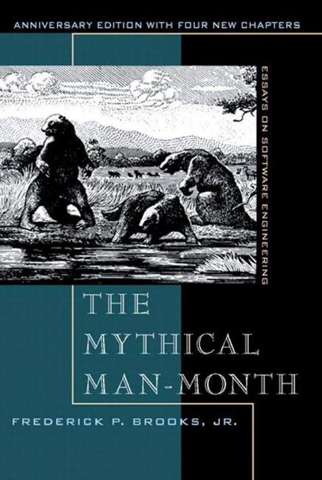
"The management question, therefore is not whether to build a pilot system and throw it away - you WILL do that. The only question is whether you plan in advance to build a throwaway, or you promise to deliver the throwaway to customers"
Notes:
Sometimes, though, we can take another approach. In 1975, Fred Brooks published a collection of essays on software engineering, called 'the mythical man-month'. Aside from the horribly archaic way Brooks refers to all software developers as "men", it's actually a book that's stood the test of time remarkably well - and on page 116, Brooks talks about something called "pilot projects". "In most systems", he says, "the first system built is barely usable. It may be too slow, too big, awkward to use, or all three. There is no alternative but to start again [ ... ] The management question, therefore is not whether to build a pilot system and throw it away - you WILL do that. The only question is whether you plan in advance to build a throwaway, or you promise to deliver the throwaway to customers". And he's absolutely right - that's a management question, because there's lots of scenarios on software engineering where the best thing you could possibly do is to ship your first prototype to real, live customers and see what they think.
I've worked on projects where we started shipping to production almost immediately, and I've worked on projects where - for all sorts of reasons - nothing actually got shipped until the end. Well, until what people with Gantt charts said was the end. In practice, that isn't how software works - that's characteristic of something called the waterfall model, and I don't think it's entirely controversial to say that the waterfall model doesn't work. In fact, I've observed something about these kinds of projects.

Slide 29
Design
Implementation
Bugfix
Testing
Launch!
Notes:
Whatever your schedule says, whatever your plan says, your 'launch date' - the first time real people use your system to solve real problems - is never at the end. If you've allocated 20% of your schedule at the end for "testing and bug fixing", you're wrong. In fact, on projects I've worked on, that point has never been later than halfway.

Slide 30
Notes:
However long you have spent working on a project - if you haven't shipped it yet, you're going to be working on it for AT LEAST this long again if you're really committed to delivering a high quality solution - and that's not a forecast, that's a lower bound. It's not uncommon for a "three month" software project to end up running for years and years without ever actually shipping anything. Of course, we don't do that - because we're all agile developers, right? Working software over comprehensive documentation, right?

Slide 31
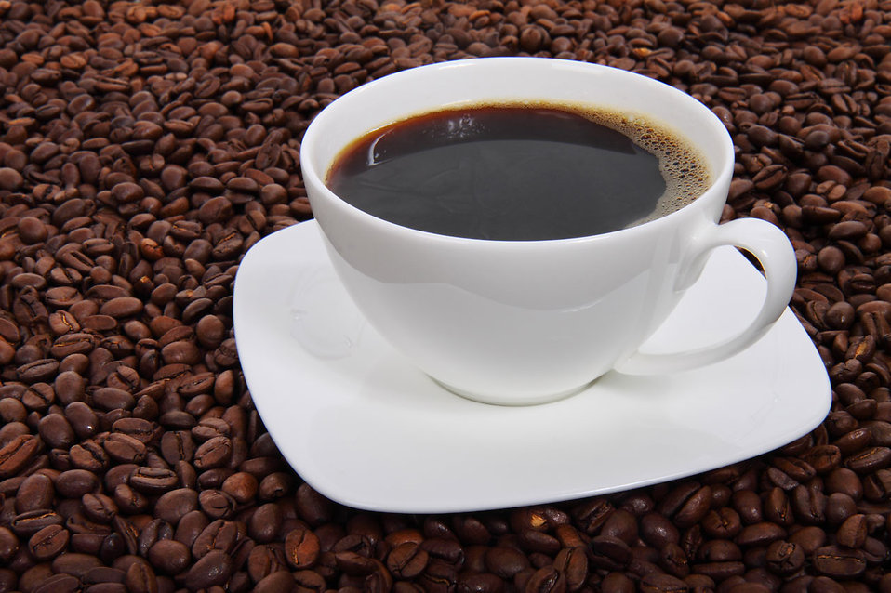
http://res.freestockphotos.biz/pictures/10/10641-a-cup-of-coffee-on-a-bean-background-pv.jpg
Notes:
There's an old joke in which Rene Descartes is having dinner, and the waiter asks if he wants anything else, and Descartes asks him for a cup of coffee without cream. The waiter comes back a few seconds later and says 'I'm terribly sorry, monsieur - but we don't have any cream. Would you like coffee without milk instead?‘
There is another, more obscure version of this joke, where Descartes is working as an agile software consultant, and he's working with a new client, and he says to them 'you know, the agile manifesto values responding to change over following a plan". And the client says "oh, that's fine, we don't have a plan anyway" - and Descartes responds with horror "but if you don't have a plan, how can you choose not to follow it!?"
See, the authors of agile manifesto knew, from their own experience, that it's important to have a plan, but as soon as you start working a project, you're going to discover all kinds of things that you didn't know when you made the plan. Sometimes, the changes you respond to are
If you've ever worked for a startup - or you've spent a lot of time in the pub with people who do - you'll have come across the idea of an MVP - a "minimum viable product". The idea here, of course, is that you strip out all the bells and whistles and try to deliver the simplest thing that can possibly work - and most MVPs are actually experiments.

Slide 32
 | A | B | C | D | E
Design
Data layer
Business logic
UI/IX
Launch
Feedback
Monitoring

Slide 33
 | A | B | C | D | E
Design
Data layer
Business logic
UI/IX
Launch
Feedback
Monitoring

Slide 35
It's not my code! It must be a problem in the database.
Notes:
NHibernate story about varchar vs nvarchar mappings, and how the query looked absolutely fine.

Slide 36
We don't need to translate our website; everybody speaks English.
Notes:
OK, how do you measure "sustainable development?" – It's kinda hard. But you can. Start by tracking velocity - not how many hours you're putting in, but how much value is being delivered.

Slide 37
Object-oriented development means your code can easily be reused in other programs

Slide 38
JavaScript is OK for browsers but you can't use it to build real systems.

Slide 39
Developers who attend conferences write better code than developers who don't.

Slide 40
Our team will be more productive if we have daily standup meetings.

Slide 41
Ruby is better than PHP.

Slide 42
The most efficient and effective method of conveying information to and within a development team is face-to-face conversation.

Slide 43
Kiitos!
dylan@dylanbeattie.net
@dylanbeattie

